Slide 1
Project: Anomaly Detection In ICSs Using SNN
Students: Michael Kaminer
Supervisors: Dr. Aviad Elyashar and Prof. Shlomo Greenberg

Slide 2
Table of Content:
Abstract
Introduction
Background
ICS
SNN
Anomaly Detection
Related Work
Next Steps
References

Slide 3


Abstract:
Industrial Control Systems (ICS) are essential for managing critical infrastructure, including power grids, water treatment plants, and manufacturing facilities. However, their increasing connectivity to external networks exposes them to cyber threats and operational anomalies. Traditional anomaly detection methods, such as statistical models and machine learning algorithms, often struggle with high-dimensional data, adaptive adversaries, and real-time processing constraints.

Slide 4


Abstract:
Spiking Neural Networks (SNN) offer a biologically inspired approach to anomaly detection, leveraging event-driven computations and temporal coding to enhance efficiency and adaptability.
This literature review explores existing methodologies for anomaly detection in ICS, evaluates the application of SNN in this domain, and identifies key challenges and opportunities for future research. By synthesizing findings from recent studies, this work aims to provide insights into the feasibility and effectiveness of SNN-based anomaly detection for securing industrial environments.

Slide 5
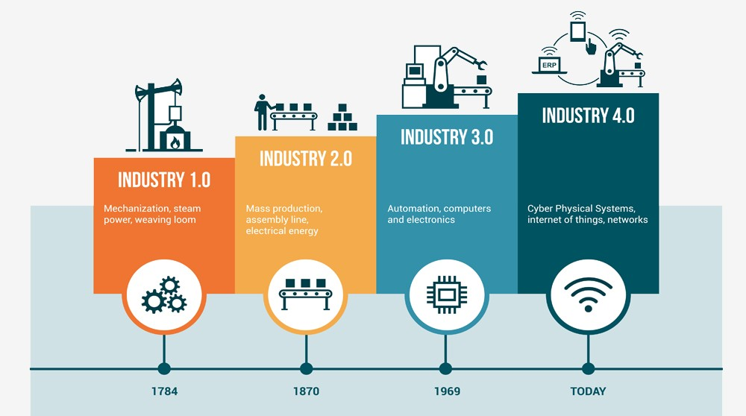
Introduction:
The Growing Importance of ICS Security:
Industrial Control Systems (ICS) are the backbone of modern critical infrastructure, enabling automation and real-time monitoring in industries such as energy, water supply, and manufacturing. economic losses, and threats to public safety.

Slide 6
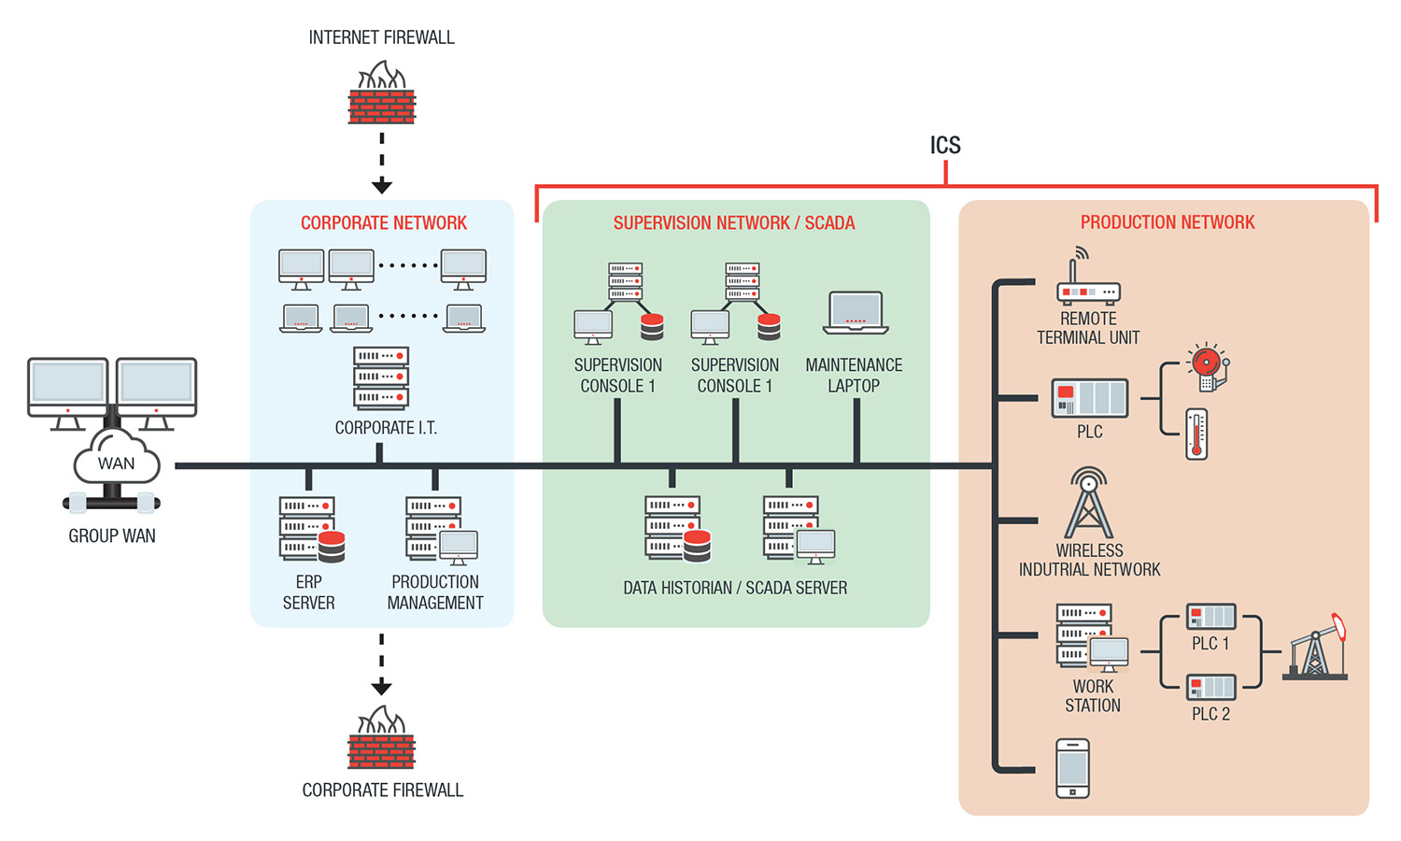
Introduction:

Slide 7
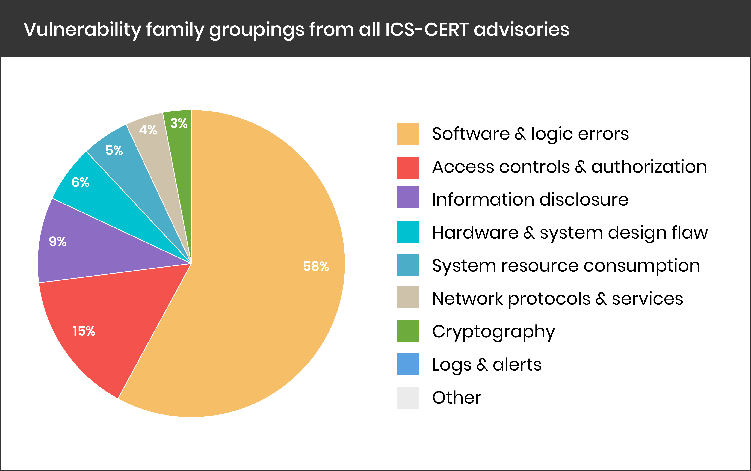
Introduction:
Challenges in Anomaly Detection for ICS
[8]

Slide 8
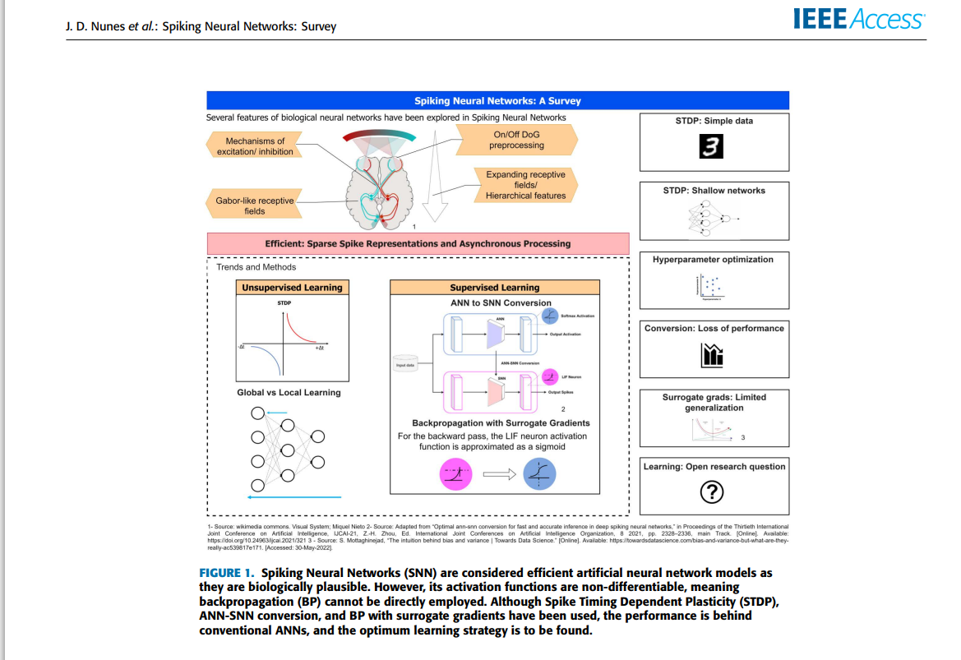
Introduction(SNN):
Spiking neural networks (SNN) represent a special class of artificial neural networks (ANN), where neuron models communicate by sequences of spikes.[11]
Due to their functional similarity to biological neurons, spiking models provide powerful tools for analysis of elementary processes in the brain, including neural information processing, plasticity and learning.[11]
[10]

Slide 9
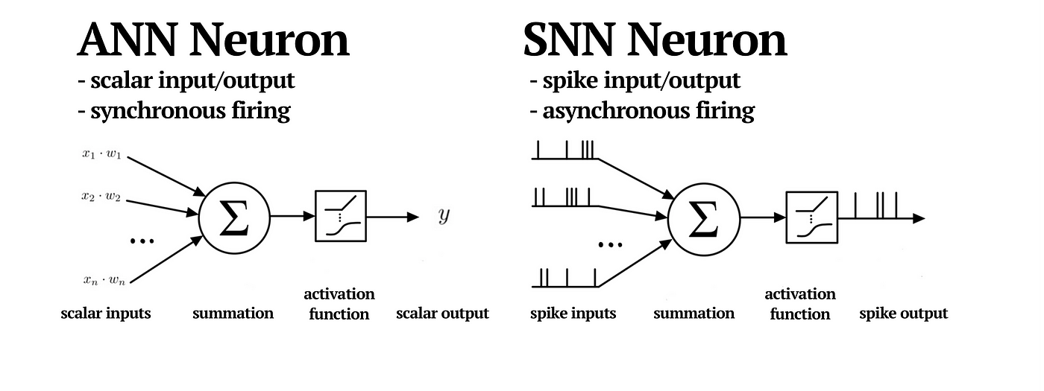
Introduction:
SNN VS ANN

Slide 10
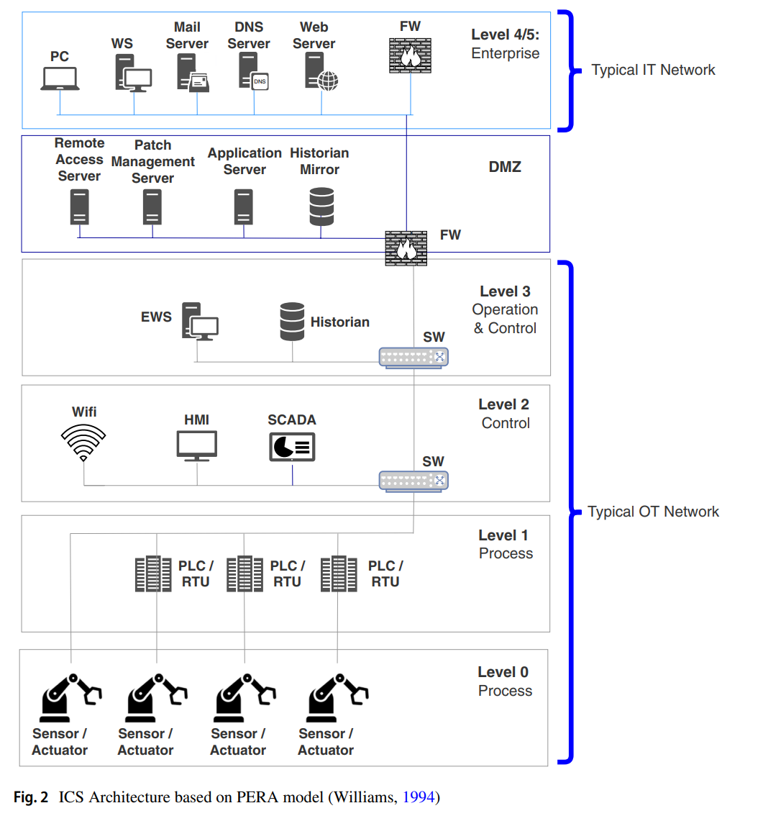
Background(ICS):
[4]

Slide 11
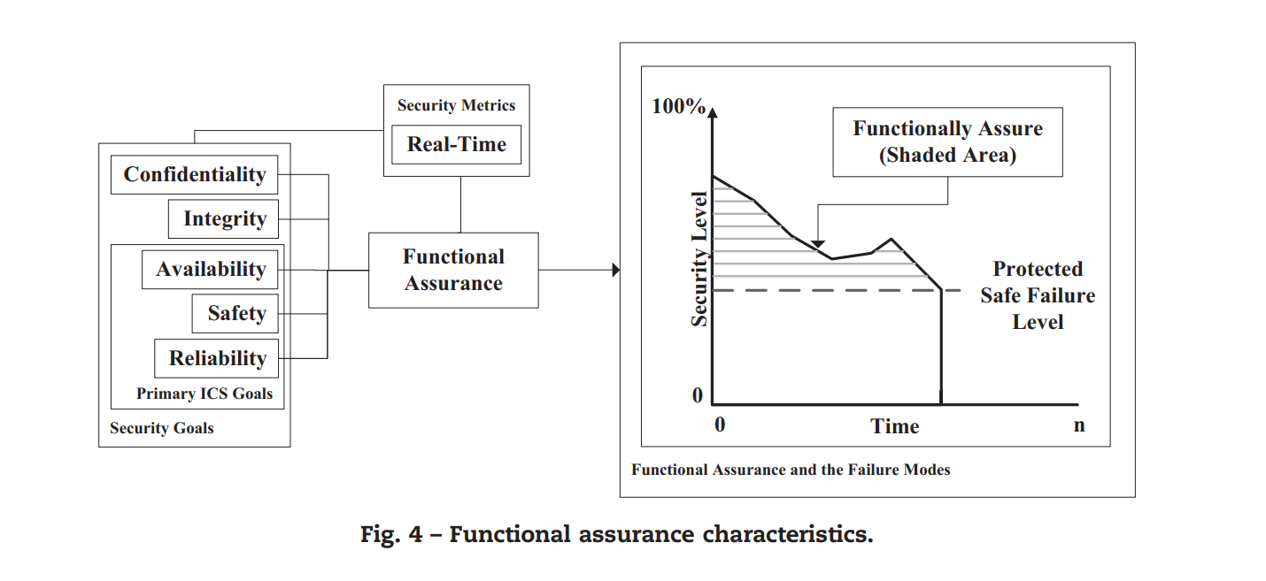
[3]

Slide 12


Background(ICS):
In recent years, security concerns related to ICS have grown significantly due to the increasing number of cyberattacks targeting critical infrastructure. The Stuxnet malware attack in 2010, which sabotaged Iran’s Natanz uranium enrichment facility by manipulating industrial control programs, highlighted the vulnerabilities of ICS to sophisticated cyber threats [2].
Similarly, in 2015, the BlackEnergy 3 malware attack on Ukraine’s power grid demonstrated how attackers could infiltrate ICS, modify control instructions, and disrupt essential services [2]. These incidents emphasize the need for advanced anomaly detection mechanisms to secure ICS against evolving cyber threats.
[7]

Slide 13
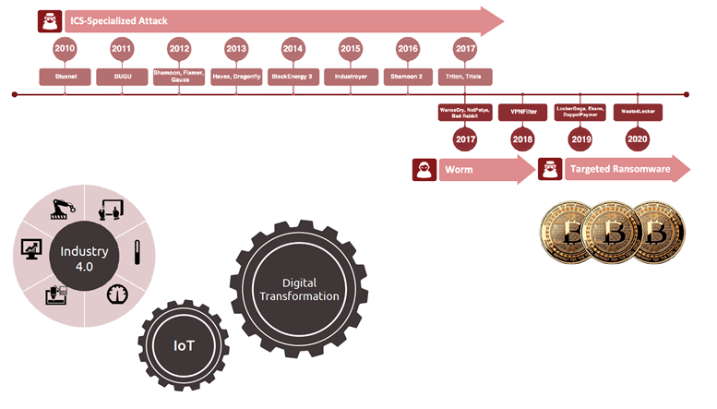
Background(ICS):
[9]

Slide 14
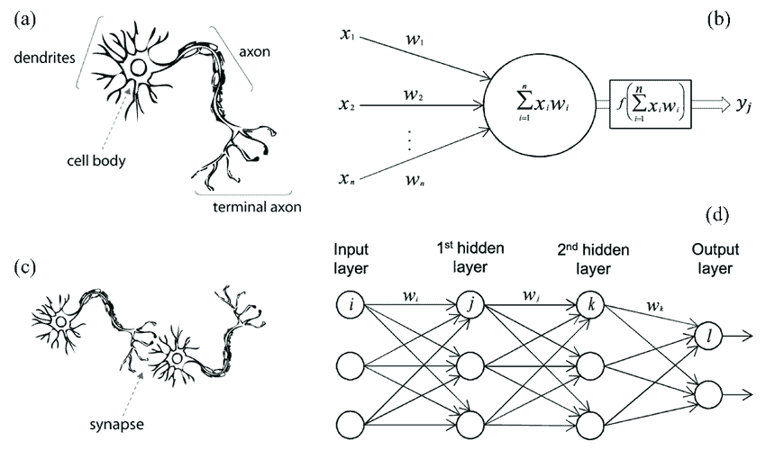
Background(SNN):
Biological neurons communicate by generating and propagating electrical pulses called action potentials or spikes (du Bois-Reymond 1848, Schuetze 1983, Kandel et al. 1991). This feature of real neurons became a central paradigm of a theory of spiking neural models.

Slide 15
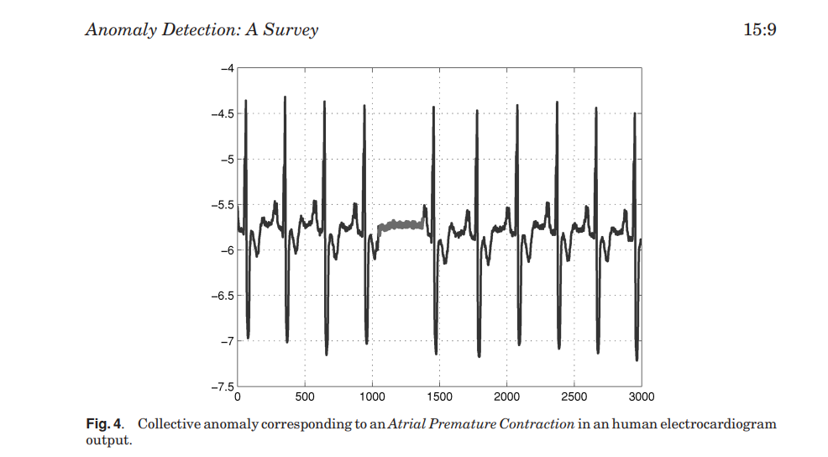
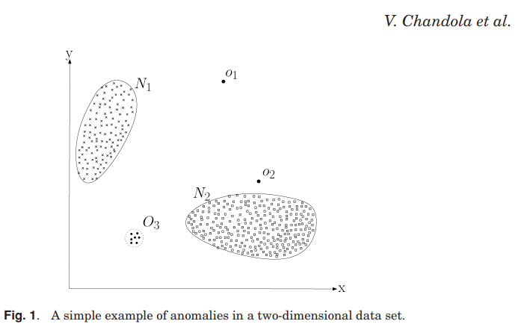
Background(Anomaly Detection):
[5]

Slide 16
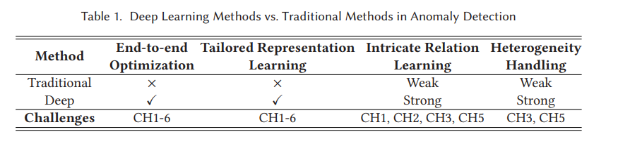
Background(Anomaly Detection):
[6]

Slide 17
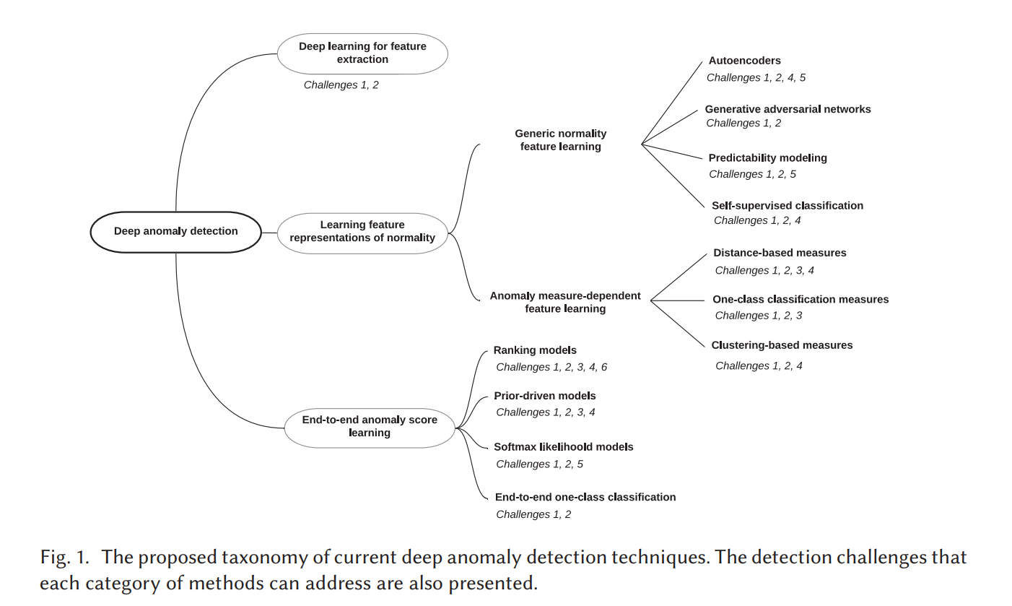
Related Work:
ANOMALY DETECTION: PROBLEM COMPLEXITIES AND CHALLENGES
Owing to the unique nature, anomaly detection presents distinct problem complexities from the majority of analytical and learning problems and tasks. This section summarizes such intrinsic complexities and unsolved detection challenges in complex anomaly data [6]
Major Problem Complexities
Unlike those problems and tasks on majority, regular or evident patterns, anomaly detection addresses minority, unpredictable/uncertain and rare events, leading to some unique problem complexities to all (both deep and shallow) detection methods:
Unknownness
Heterogeneous anomaly classes
Rarity and class imbalance
Diverse types of anomaly[6]
[6]

Slide 18
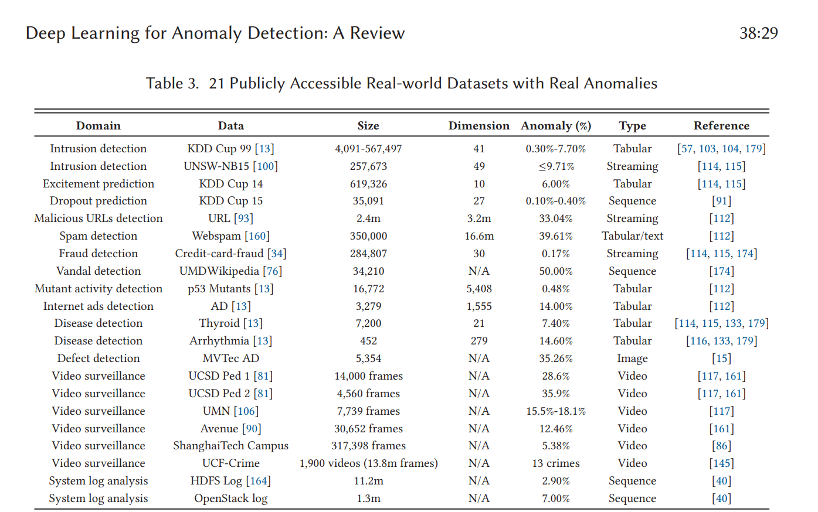
Related Work:
Datasets with Real Anomalies : One main obstacle to the development of anomaly detection is the lack of real-world datasets with real anomalies. Many studies evaluate the performance of their presented methods on datasets converted from popular classification data for this reason. This way may fail to reflect the performance of the methods in real-world anomaly detection applications.
[6]
[6]

Slide 19
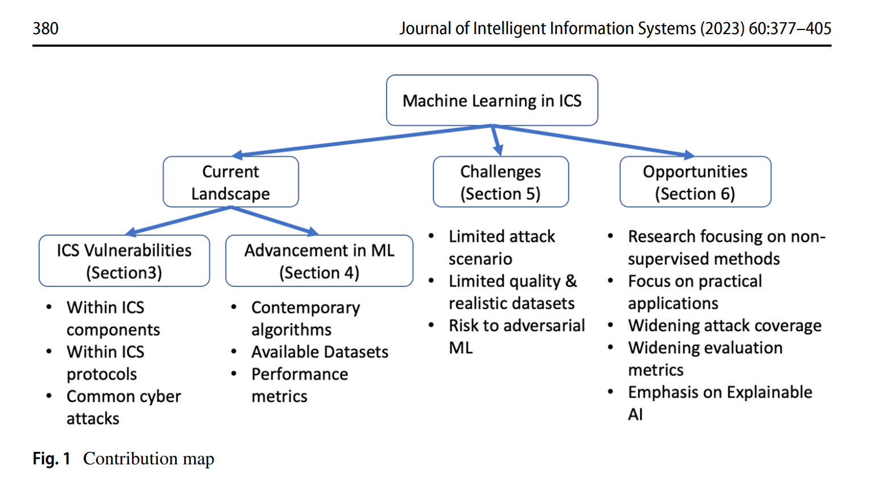
Related Work:
Existing surveys usually focus on specific types of ICS cyber attacks. [4]
[4]

Slide 20
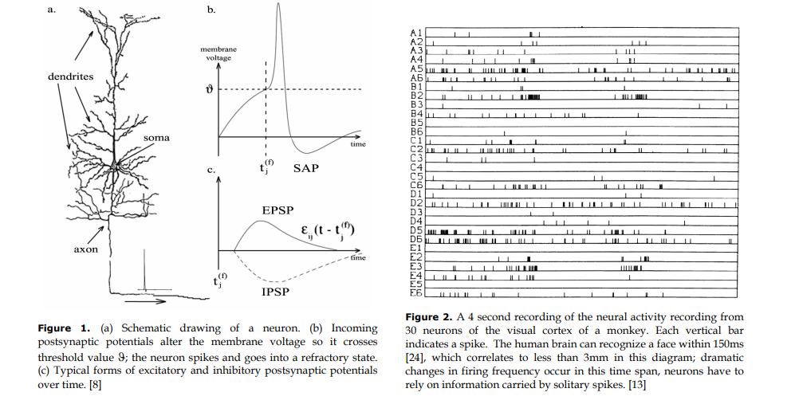
Related Work:
Spike coding
There are many different schemes for the use of spike timing information in neural computation. Because of the nature of this paper, we’ll only cover two models here: the spike response and the integrate-and-fire model. Both are instances of the general threshold-fire model.[12]

Slide 21
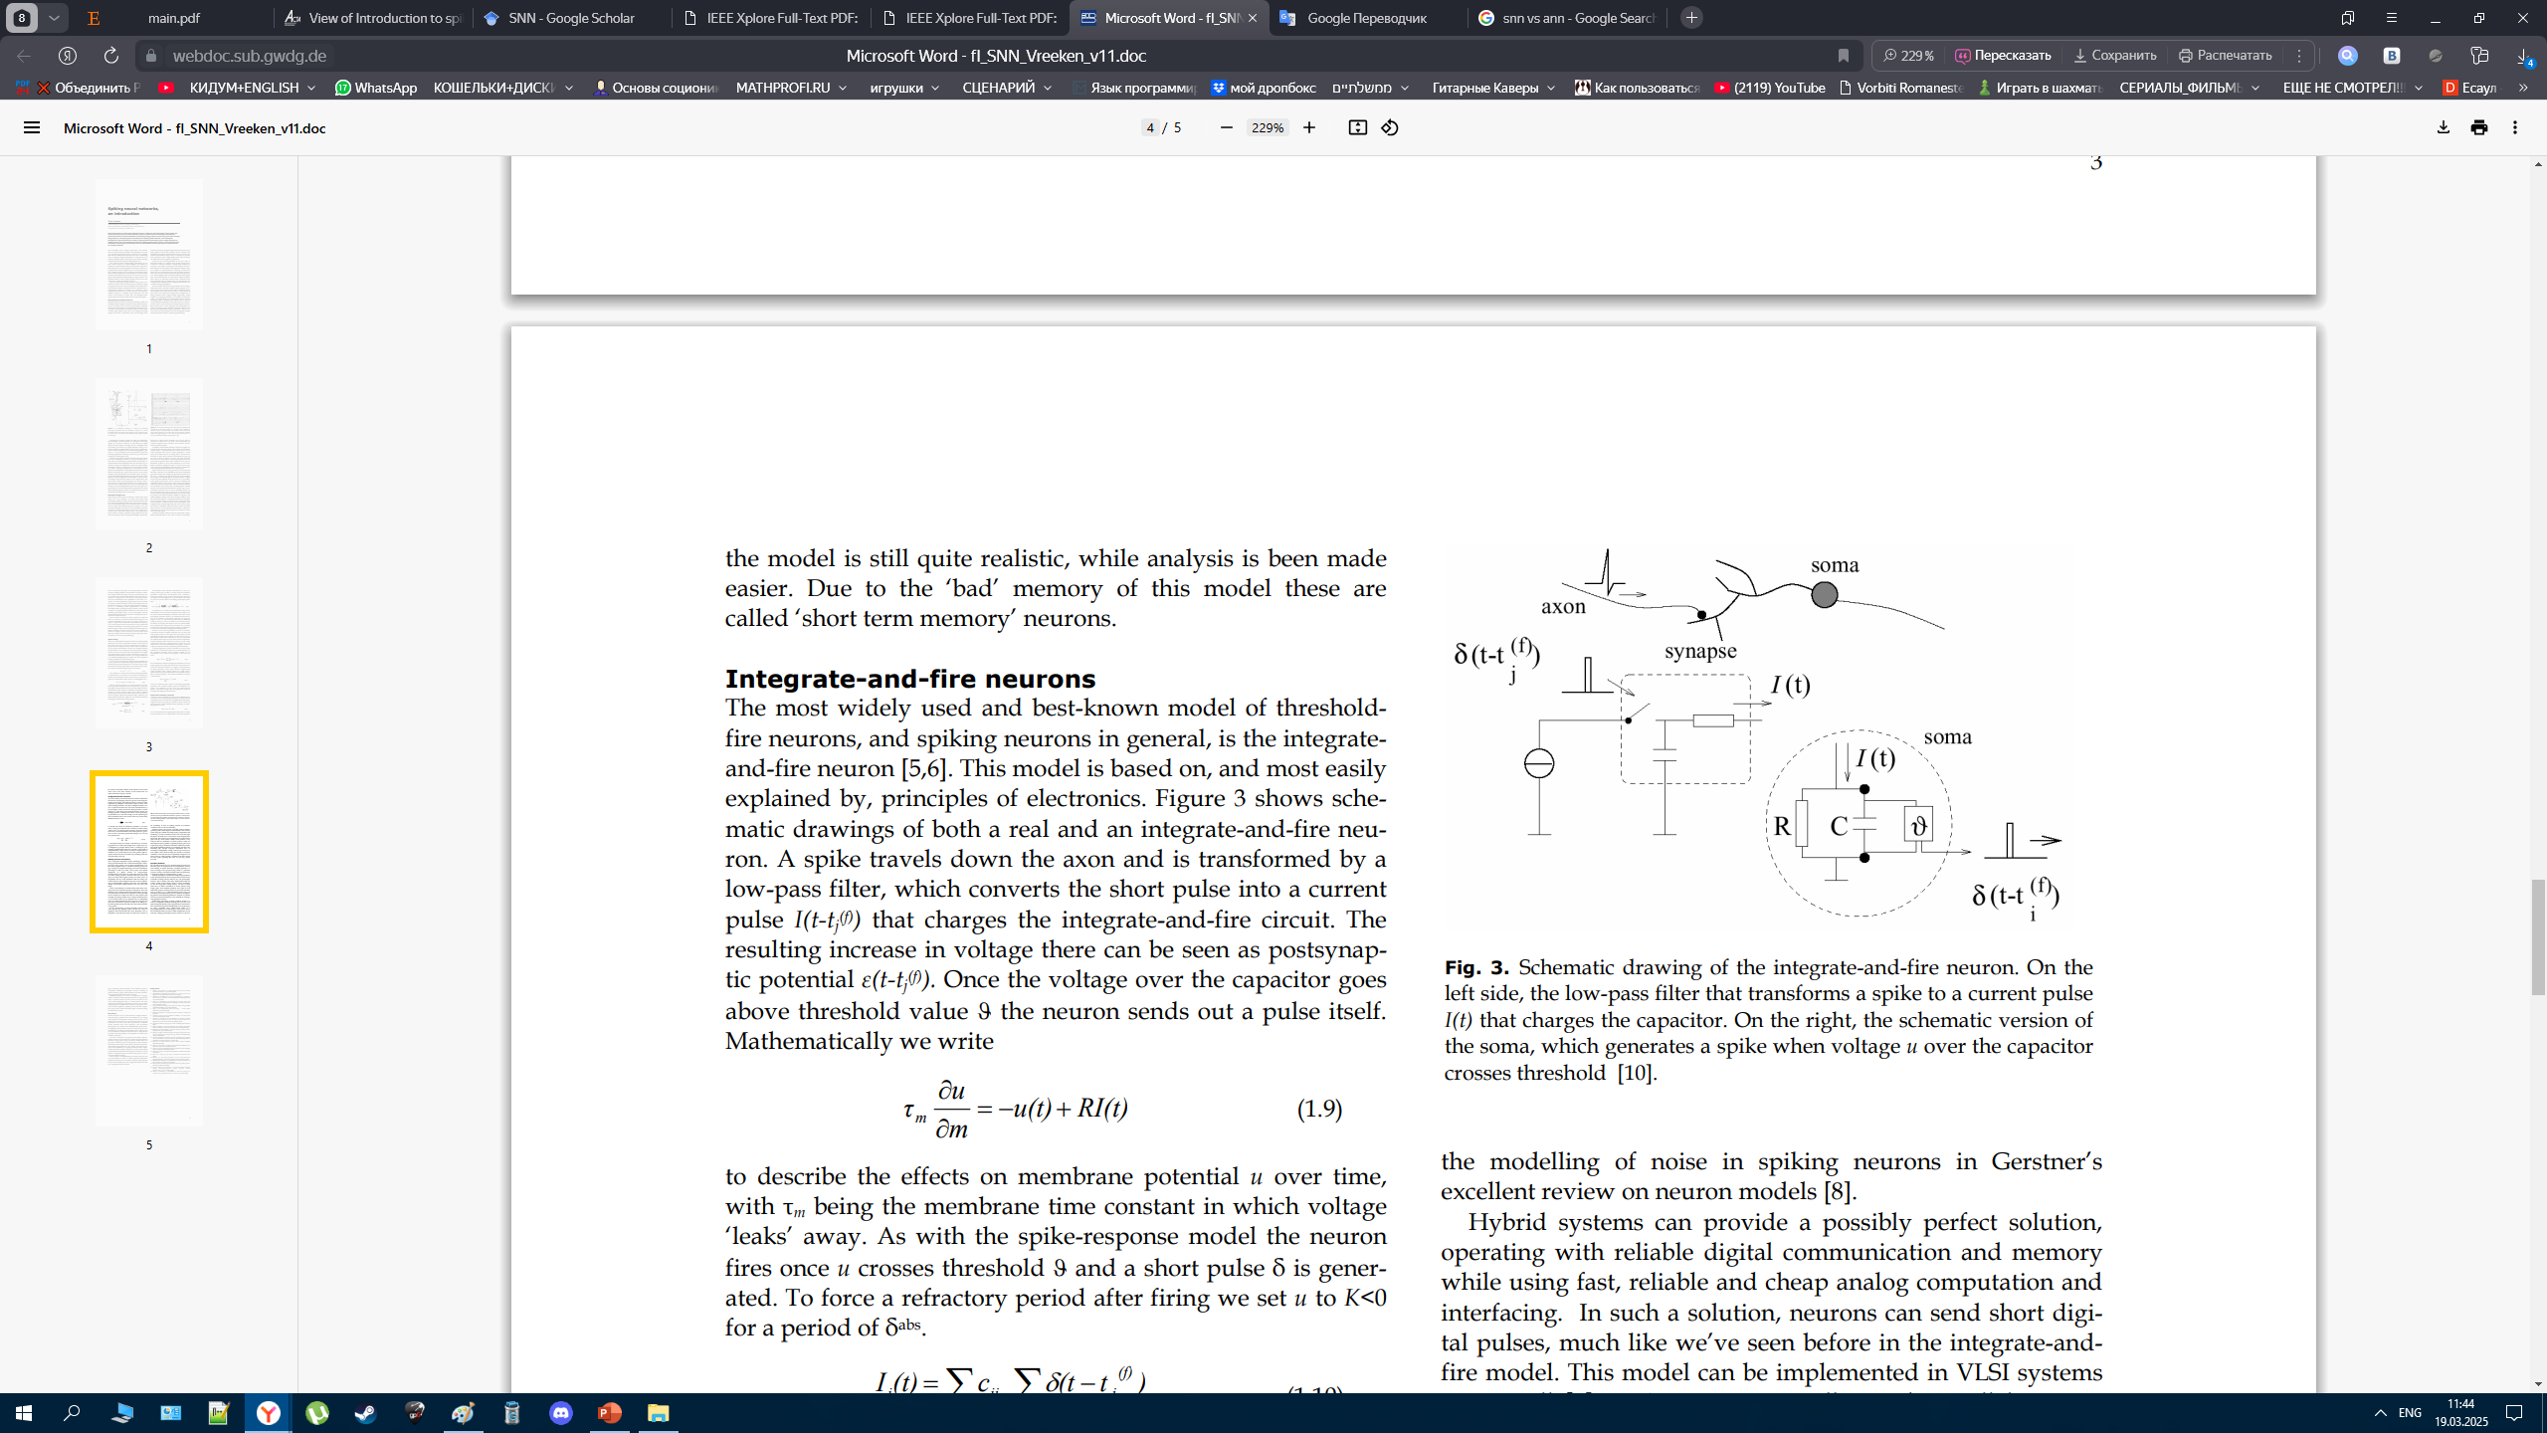
Related Work:
Short-term memory neurons
Analysis of neural networks has always been difficult and is even more so in a spatial-temporal domain as with networks of spiking neurons.
For normal operation 4 the model is still quite realistic, while analysis is been made easier. Due to the ‘bad’ memory of this model these are called ‘short term memory’ neurons. [12]
[12]

Slide 22
Methodology and Next Steps:
To investigate the potential of Spiking Neural Networks (SNNs) for anomaly detection in Industrial Control Systems (ICS), the following methodological approach will be taken:
Review of Anomaly Detection Algorithms
Analyze existing anomaly detection methods used in ICS.
Identify the strengths and weaknesses of traditional techniques, including rule-based, statistical, and ML/DL-based approaches.
Selection of Machine Learning (ML) and Deep Learning (DL) Techniques
Evaluate different ML and DL algorithms that have been applied to ICS security.
Compare these methods to determine their suitability for real-time anomaly detection.
Dataset Exploration and Selection
Search for publicly available datasets containing real or simulated ICS anomalies.
Assess the quality and diversity of these datasets to ensure a reliable evaluation.
Implementation of SNN-Based Anomaly Detection
Identify and obtain an existing SNN framework suitable for anomaly detection.
Train and fine-tune the model using the selected datasets.
Experimental Evaluation and Performance Analysis
Compare the accuracy, efficiency, and generalization capability of SNN with conventional anomaly detection models.
Assess the impact of noise, data imbalance, and adversarial attacks on detection performance.
By following this structured methodology, the study aims to determine whether SNNs can provide a robust and efficient alternative to traditional ICS anomaly detection approaches.

Slide 23

Methodology and Next Steps:
Also, we found a huge library called SNN-torch.
Now our main goal is to learn 7 lessons course by the creators of this library.
We trained our first SNN on the MNIST dataset. Now it can work exactly as a CNN.
Below you can see a short video of how spikes identify the number ‘3’ (test) after we trained our SNN.[14]

Slide 24
References:
[1] K. Stouffer, S. Lightman, V. Pillitteri, M. Abrams, and A. Hahn, Guide to Industrial Control Systems (ICS) Security: Supervisory Control and Data Acquisition (SCADA) Systems, Distributed Control Systems (DCS), and Other Control System Configurations such as Programmable Logic Controllers (PLC), NIST Special Publication 800-82, Rev. 2 (Initial Public Draft), National Institute of Standards and Technology, 2014.
[2] Y. Hu, A. Yang, H. Li, Y. Sun, and L. Sun, “A survey of intrusion detection on industrial control systems,” International Journal of Cyber Security and Digital Forensics, first published online Aug. 17, 2018.
[3] W. Knowles, D. Prince, D. Hutchison, J. F. P. Disso, and K. Jones, “A survey of cyber security management in industrial control systems,” Computers & Security, Mar. 2015.
[4] A. M. Y. Koay, R. K. L. Ko, H. Hettema, and K. Radke, “Machine learning in industrial control system (ICS) security: Current landscape, opportunities and challenges,”. May, 2022. p.380(p.4 pdf)
[5] Chandola, V., Banerjee, A., and Kumar, V. 2009. Anomaly detection: A survey. ACM Comput. Surv. 41, 3, Article 15 (July 2009), 58 pages. DOI=10.1145/1541880.1541882 http://doi.acm.org/10.1145/1541880.1541882
[6] Guansong Pang, Chunhua Shen, Longbing Cao, and Anton van den Hengel. 2021. Deep Learning for Anomaly Detection: A Review. ACM Comput. Surv. 54, 2, Article 38 (March 2021), 38 pages. https://doi.org/10.1145/3439950
[7] Antiy Security Response. (2016, March 16). Comprehensive Analysis Report on Ukraine Power System Attacks.
[8] https://www.ncsc.gov.bh/en/cyberwiser/ics.html
[9] https://www.trendmicro.com/en_us/research/22/c/an-in-depth-look-at-ics-vulnerabilities-part-1.html
[10] J. D. Nunes, M. Carvalho, D. Carneiro, and J. S. Cardoso, “Spiking neural networks: A survey,” IEEE Access, vol. 10, Jun. 2022, doi: 10.1109/ACCESS.2022.3179968.
[11] F. Ponulak and A. Kasiński, “Introduction to spiking neural networks: Information processing, learning and applications,” Acta Neurobiologiae Experimentalis, vol. 71, pp. 409–433, 2011.
[12] J. Vreeken, Spiking Neural Networks: An Introduction, 2003.
[13] SWAT: A Spiking Neural Network Training Algorithm for Classification Problems John J. Wade, Liam J. McDaid, Jose A. Santos, and Heather M. Sayers
[14] https://snntorch.readthedocs.io/

